Slide 1
Digital Portfolio
STUDENT NAME: Yadu Krishnan.H
REGISTER NO AND NMID: 2428C0527
DEPARTMENT: B.Sc AI & ML
COLLEGE: KPR College of Arts Science and Research, Bharathiar University

Slide 2
PROJECT TITLE
Sports Medicine Specialist Portfolio

Slide 3


AGENDA
Problem Statement
Project Overview
End Users
Tools and Technologies
Portfolio design and Layout
Features and Functionality
Results and Screenshots
Conclusion
Github Link
3/21/2024 Annual Review

Slide 4

PROBLEM STATEMENT
Athletes often get injured due to lack of proper guidance.
Recovery and performance tips are not easily available in one place.
Skills of sports medicine specialists are not shown clearly in normal resumes.
A clear online portfolio is needed to highlight skills and services.

Slide 5

PROJECT OVERVIEW
This project creates an online portfolio for a Sports Medicine Specialist.
The portfolio shows personal details, skills, and services in a clear way.
It uses modern design with 3D effects for a stylish and professional look.
It helps athletes, trainers, and organizations easily connect with the specialist.

Slide 6

WHO ARE THE END USERS?
Athletes – who need injury prevention and recovery guidance.
Sports Coaches & Trainers – who want expert support for their teams.
Rehabilitation Centers – looking for specialists in recovery programs.
Sports Organizations & Clubs – to hire or consult with experts.
General Public – anyone interested in fitness, therapy, or sports health.

Slide 7

TOOLS AND TECHNIQUES
HTML5 – to create the structure of the portfolio.
CSS3 – for styling, colors, and 3D effects.
JavaScript – to add interactivity and animations.
Responsive Design – to make the portfolio work on mobile and desktop.
Web Hosting Platforms – to publish the portfolio online.

Slide 8
POTFOLIO DESIGN AND LAYOUT
Modern, clean layout with structured sections for smoothreadability
Sections: Home, About Me, Skills/Events Showcase,Projects/Achievements, Contact
Event-themed colors: Gold (highlights/headings) & Dark Blue(backgrounds/buttons)
Interactive 3D hover effects on cards and sticky navigation barfor smooth scrolling
Responsive design with glassmorphism cards, floating elements,and animated skill meters
8

Slide 9
FEATURES AND FUNCTIONALITY
Smooth scrolling navigation with sticky menu for easy access to all sections
Interactive 3D skill cards with hover effects to highlight expertise
Contact form with validation and instant submission feedback
Responsive design ensuring seamless experience on desktop, tablet, and mobile
Animated sections and floating elements to enhance engagement and visual appeal

Slide 10
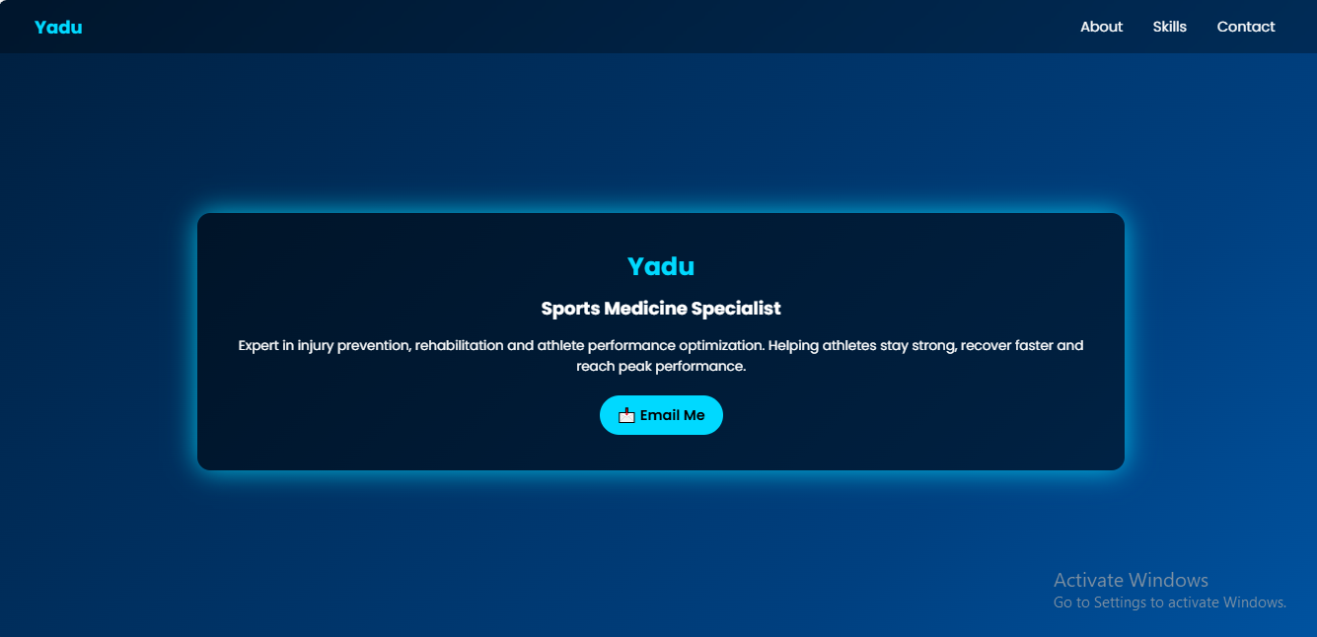
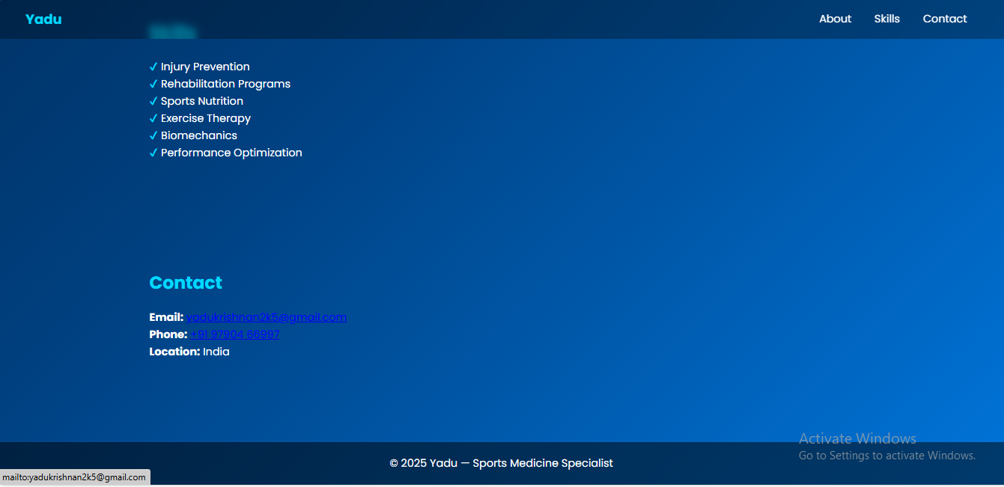

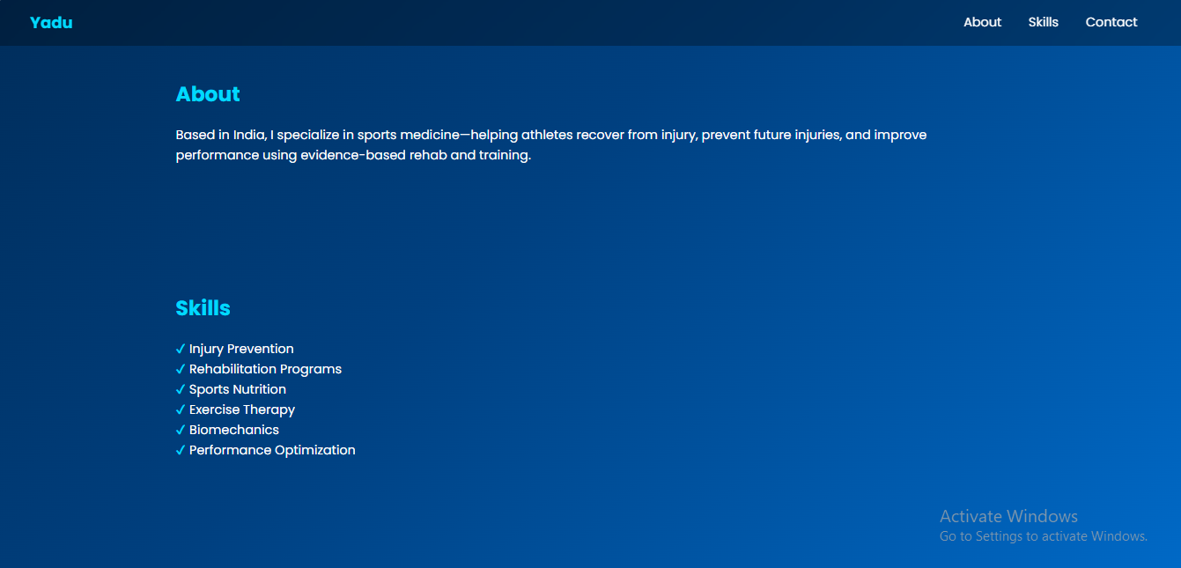
RESULTS AND SCREENSHOTS
Results:
Professionally designed portfolio showcasing skills and expertise clearly
Enhanced user engagement through interactive 3D effects and animations
Easy navigation and accessibility across all devices
Screenshot:
3/21/2024 Annual Review
10

Slide 11
CONCLUSION
A modern, visually appealing portfolio tailored for a Sports Medicine Specialist
Interactive 3D elements effectively highlight skills and expertise
Smooth navigation and responsive design improve user experience across devices
Clear presentation of About, Skills, Help, and Contact sections ensures professional communication
Engaging design and animations create a lasting impression on visitors
11

Slide 12
GIT HUB LINK
https://github.com/yadukrishnan2k5-ux/naan-muthalvan.git

